Slide 1
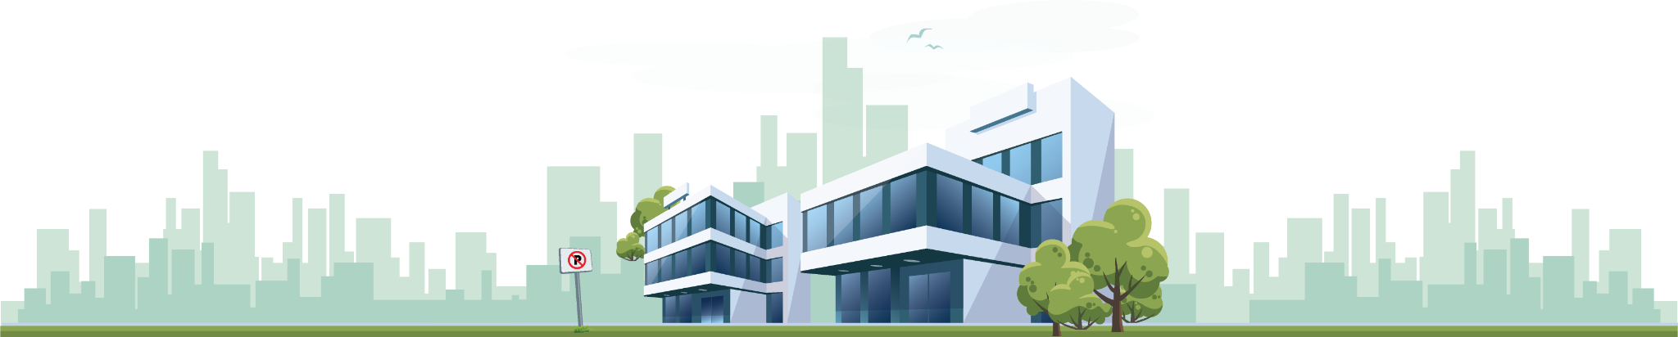
Predicting Real Estate King County
Selling Prices
Regression Models Performance
André
Jordi
Sandra
Francisco for moral support

Slide 2

Our Goals
Build a machine learning model to predict the selling prices of houses in King County, Washington State;
Compare performance of different Regression Machine Learning Models;
Choose the best Model after improvements;
Identify key points to improve Real Estate Business with Tableau Dashboard;

Slide 3
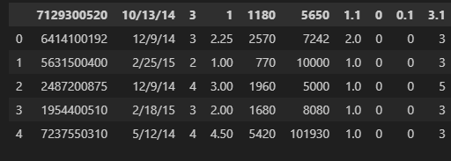
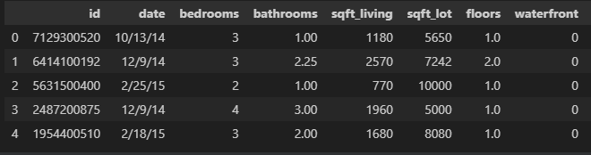
Before starting to build our Models
Add and standardize column names Data types (datetime, floats…) Imperial vs Metric System Duplicates Nulls | Drop Irrelevant Columns EDA on continuous numerical and discrete numerical Pre-processing (scaling, transformations, outliers, feature extraction)

Slide 4
Bucketing
Views - Viewed or not
Property Age - Age group
Renovated - renovated or not
Quarter - months into quarters
Fortnight - days into fortnights
Bigger or not - if the lot or the living area became bigger after renovation or not

Slide 5
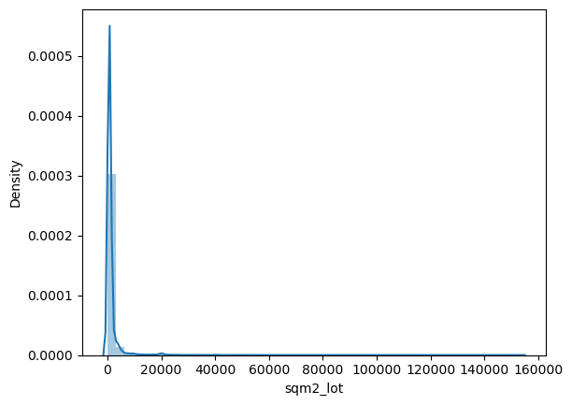
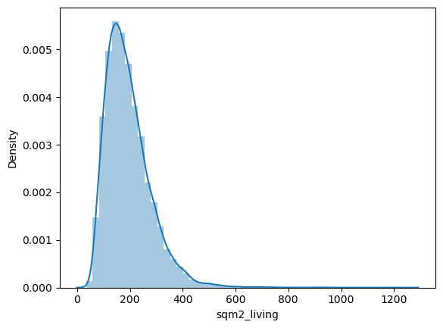
Exploratory Data Analysis
Continuous Numerical

Slide 6
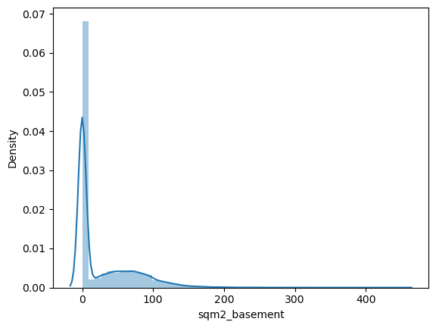
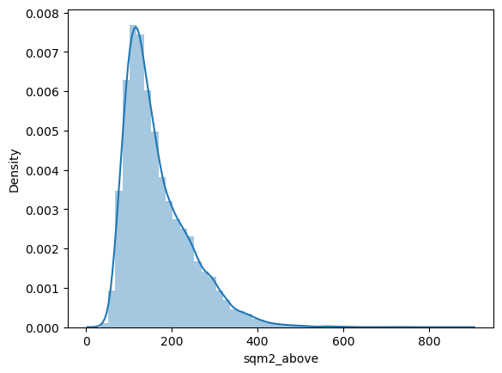
Exploratory Data Analysis
Continuous Numerical

Slide 7
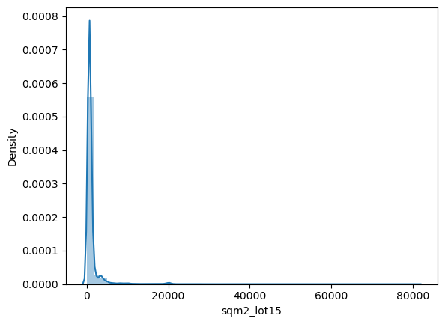
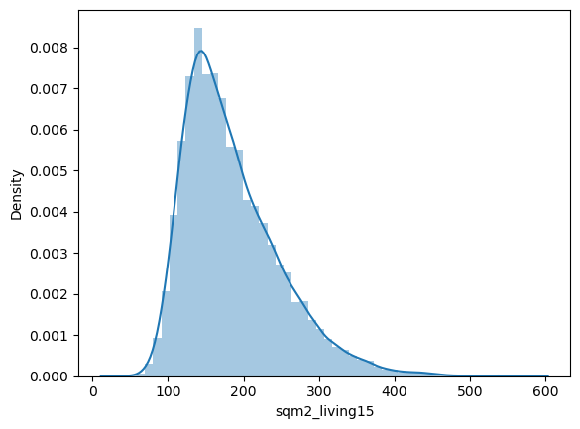
Exploratory Data Analysis
Continuous Numerical

Slide 8
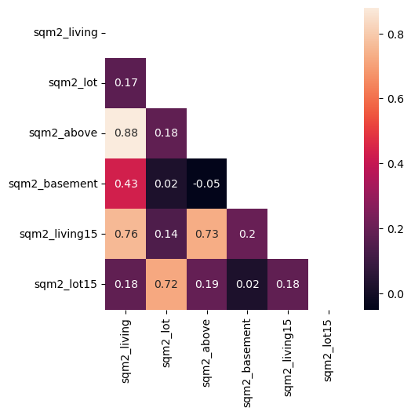
Correlation Matrix

Slide 9


Regression Metrics
R2 Score
Linear Regression | KNN Regressor | Random Forest Regressor
0,37 - without outliers 0,64 0,30 - BoxCox | 0,51 0,28 - without outliers 0,27 - Box Cox | 0,73

Slide 10
Visualizing Models

Slide 11
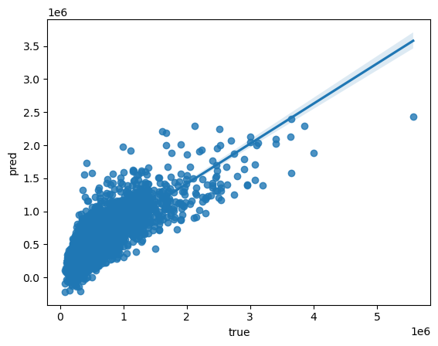
Linear Regression
Scalers but without Transformers

Slide 12
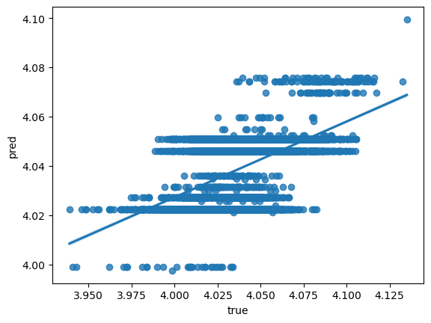
Linear Regression
Box-Cox

Slide 13
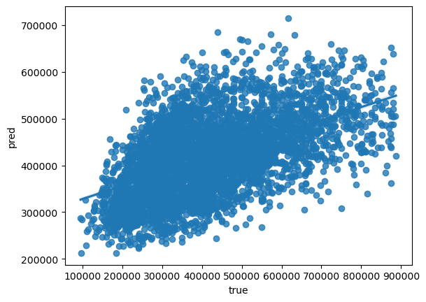
Linear Regression
Outliers Removed

Slide 14
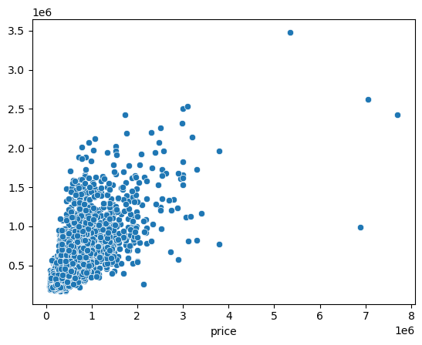
KNN Regression

Slide 15
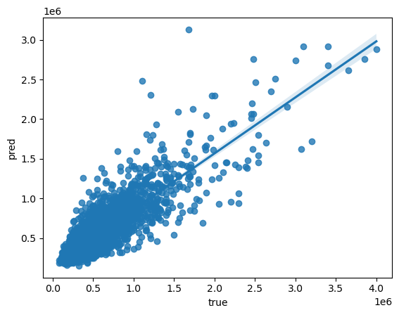
Random Forest Regression

Slide 16
Why RandomForest?
The Random Forest Model is a great tool to use to improve predictive models.
Adding more trees can improve the performance of the model, but decreases the returns, and too many trees can lead to overfitting or slow training/prediction times.
It uses Cross-Validation, a useful method that splits the data in a training and validation sets. It finds the number of trees that give the best performance, by trying out different values and evaluating performance on a validation set.
Preprocessing the data and considering feature selection/engineering techniques are also important for optimizing random forest performance.

Slide 17
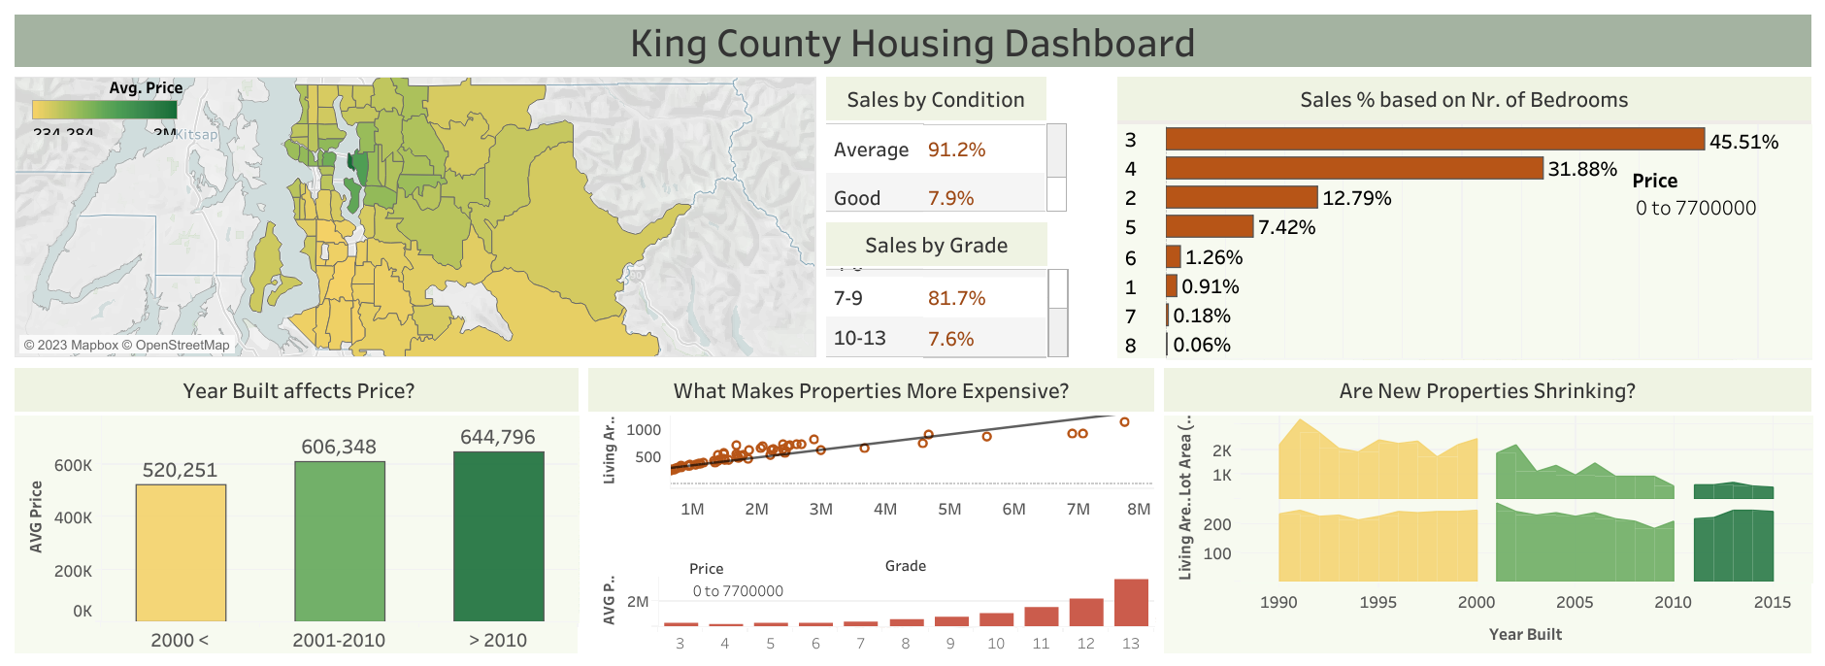
https://public.tableau.com/app/profile/sandra.cunha/viz/MIDPROJECT_V2/10_DASHBOARD?publish=yes

Slide 18

What to look for if Real Estate Company wants to improve sales in King County?

Slide 19
Add to Real Estate Property Portfolio:
3 - 4 Bedrooms Houses;
Prioritize Living Area (Lot Area has been decreasing over time while Living Area remains the same);
Grade (7-9 higher selling rates);
New properties instead of Old ones;

Slide 20
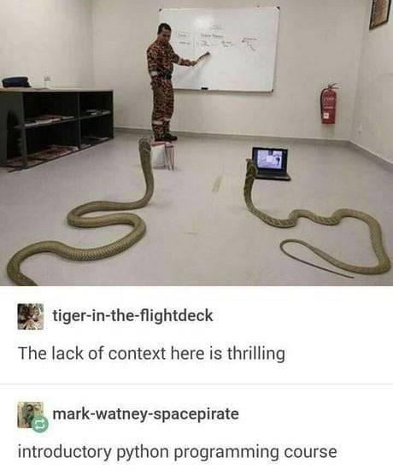
Thank You for Listening!
Questions?

